Slide 1
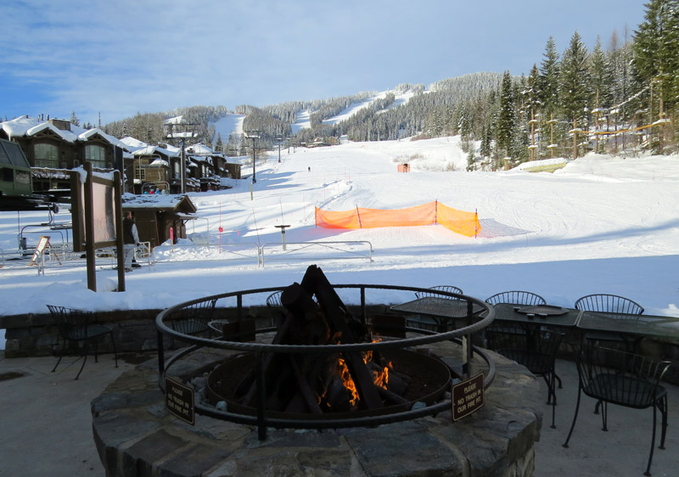
Big Mountain Ski Resort
Ticket Pricing Model

Slide 2
Purpose of this project
Provide support for pricing and future facility investment
Set up an evaluating model for ski resort tickets inside their market fragment.
Construct a predictive model for ticket cost
Number of facilities or properties at resorts
Give understanding into what facilities make the biggest difference to vistors
Which facilities they are most likely to pay for

Slide 3
Key Findings
Permanent closure of up to 10 of the least used runs
Can close upto 5 runs results in drop in ticket prices and revenue
Increasing vertical drop by 150ft and adding a chair lifts
Display ticket price increase of $8.67 and potential of generating revenue of $15 million
Number 2 plus the addition of 2 acres of snow making
Display ticket price increase of $10.59 and potential of generating revenue of $18.5 million
Increasing the longest run in resort by 0.2 miles (boasting the longest run) and adding snow making of 4 acres
There is no change in ticket price
Recommendation
Increase vertical drop by 150ft with the addition of a chair lift and 2 acres of snow making.
Justifies ticket price increase of $10.59 and will generate additional revenue of $18.5 million/year

Slide 4
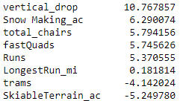
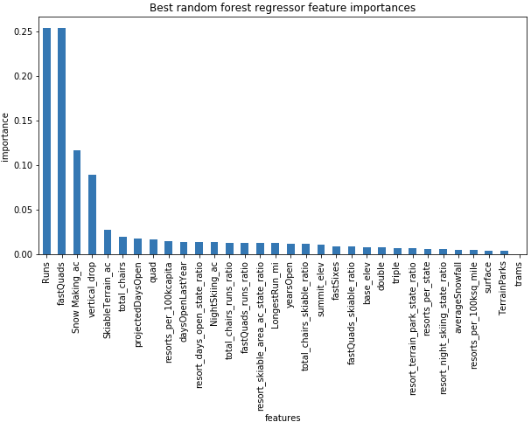
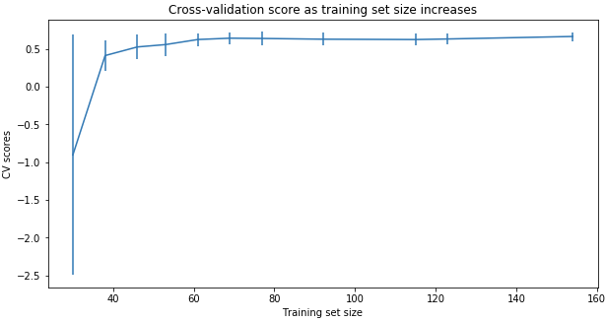
Modeling Comparison
Linear Regression Model vs. Random Forest Regression Model
( MAE, std) 10.499, 1.622 vs. 9.649, 1.505
Cross-Validation Score
Notes:
The random forest model has a lower cross-validation mean absolute error (MAE errors between paired observations expressing the same phenomenon) by almost $1. It also exhibits less variability. Verifying performance on the test set produces performance consistent with the cross-validation results. (10.499032338015294, 1.6220608976799664) vs. (9.649477185159107, 1.505326312688125)
This shows that you seem to have plenty of data. There's an initial rapid improvement in model scores as one would expect, but it's essentially levelled off by around a sample size of 40-50

Slide 5
Modeling Data
Modelled price is $95.86 vs. actual price $81.00
Model display $15 increase in profit
MAE = $10.36 conveys there is room for an increase of profit
Pricing Assumptions
Different resorts set their costs based on the market
Big Mountain gives off an impression of being charging considerably less than expectation proposes
Is Big Mountain undercharging?
Are other resorts overpriced?
Is our model missing some important data
Operation Costs
Maintenance cost

Slide 6
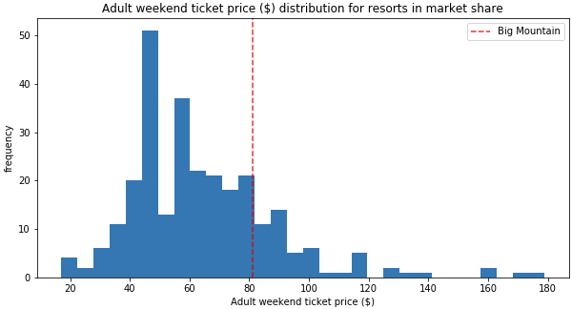
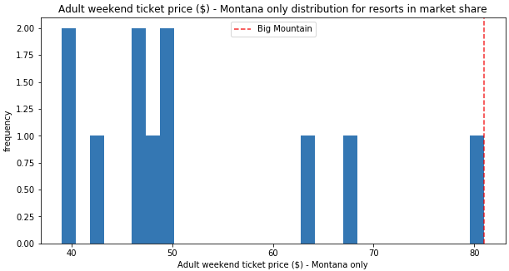
Big Mountain Resort Ticket Prices

Slide 7
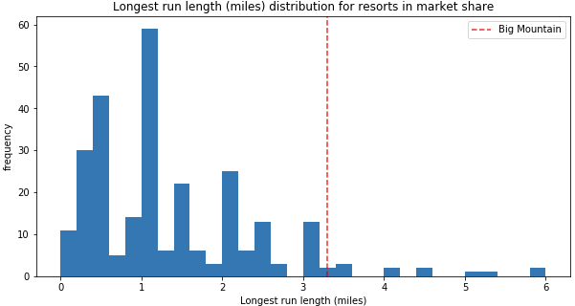
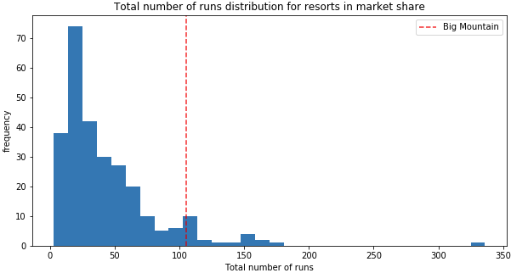
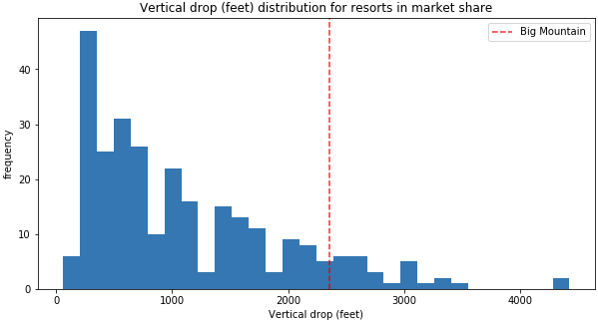
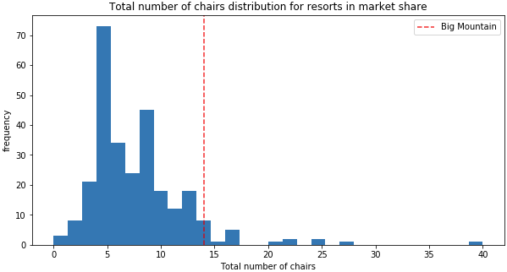
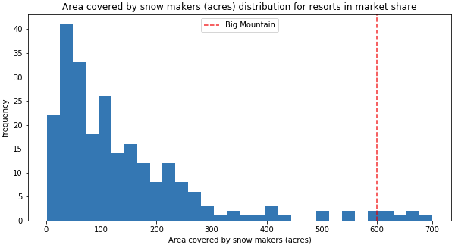
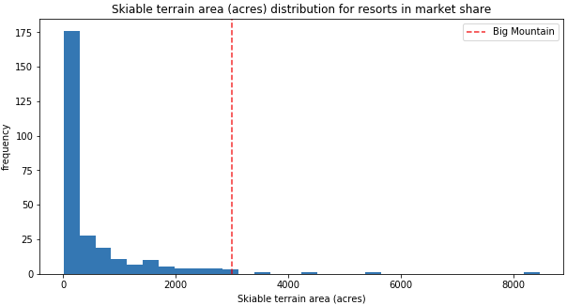
Feature Comparisons

Slide 8
Summary
Big Mountain Currently ranks among the top resorts
Skiable terrain
Number of Runs
Snow making capacity
Number of Chairs
Vertical Drop Length
Length of Runs
Proposed Scenerios
Shutting down at most 5 least used runs
Increase vertical drop with snowmaking
Increase vertical drop without snowmaking
Increase longest run with snowmaking
By expanding the vertical drop either with or without snowmaking will give the chance to increment incomes by $15-$18 million, but the inflate cost of tickets should be thought of.

